Slide 1
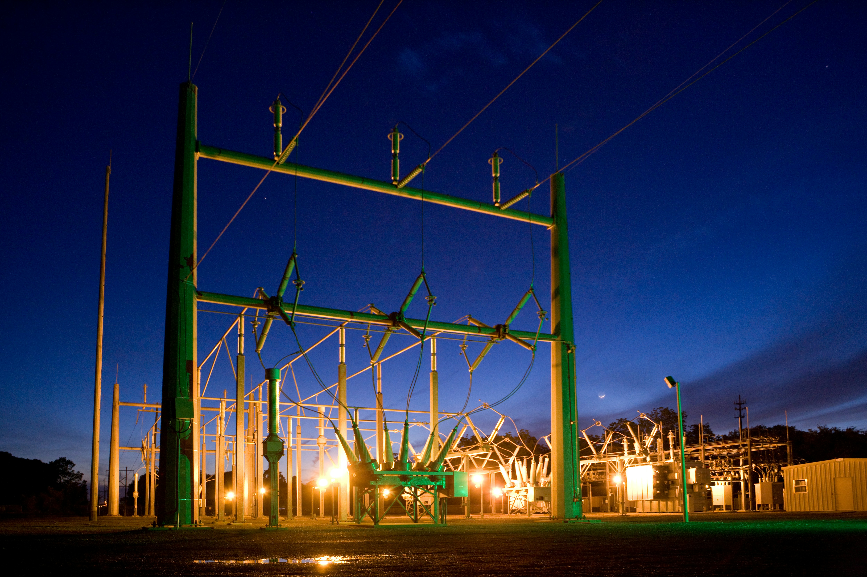
Real-Time Quality Index Estimation for Redundant Sampled Values Streams in Digital Substations
Everton Matheus Oriente
Master’s degree in Critical Computing Systems Engineering

Slide 2
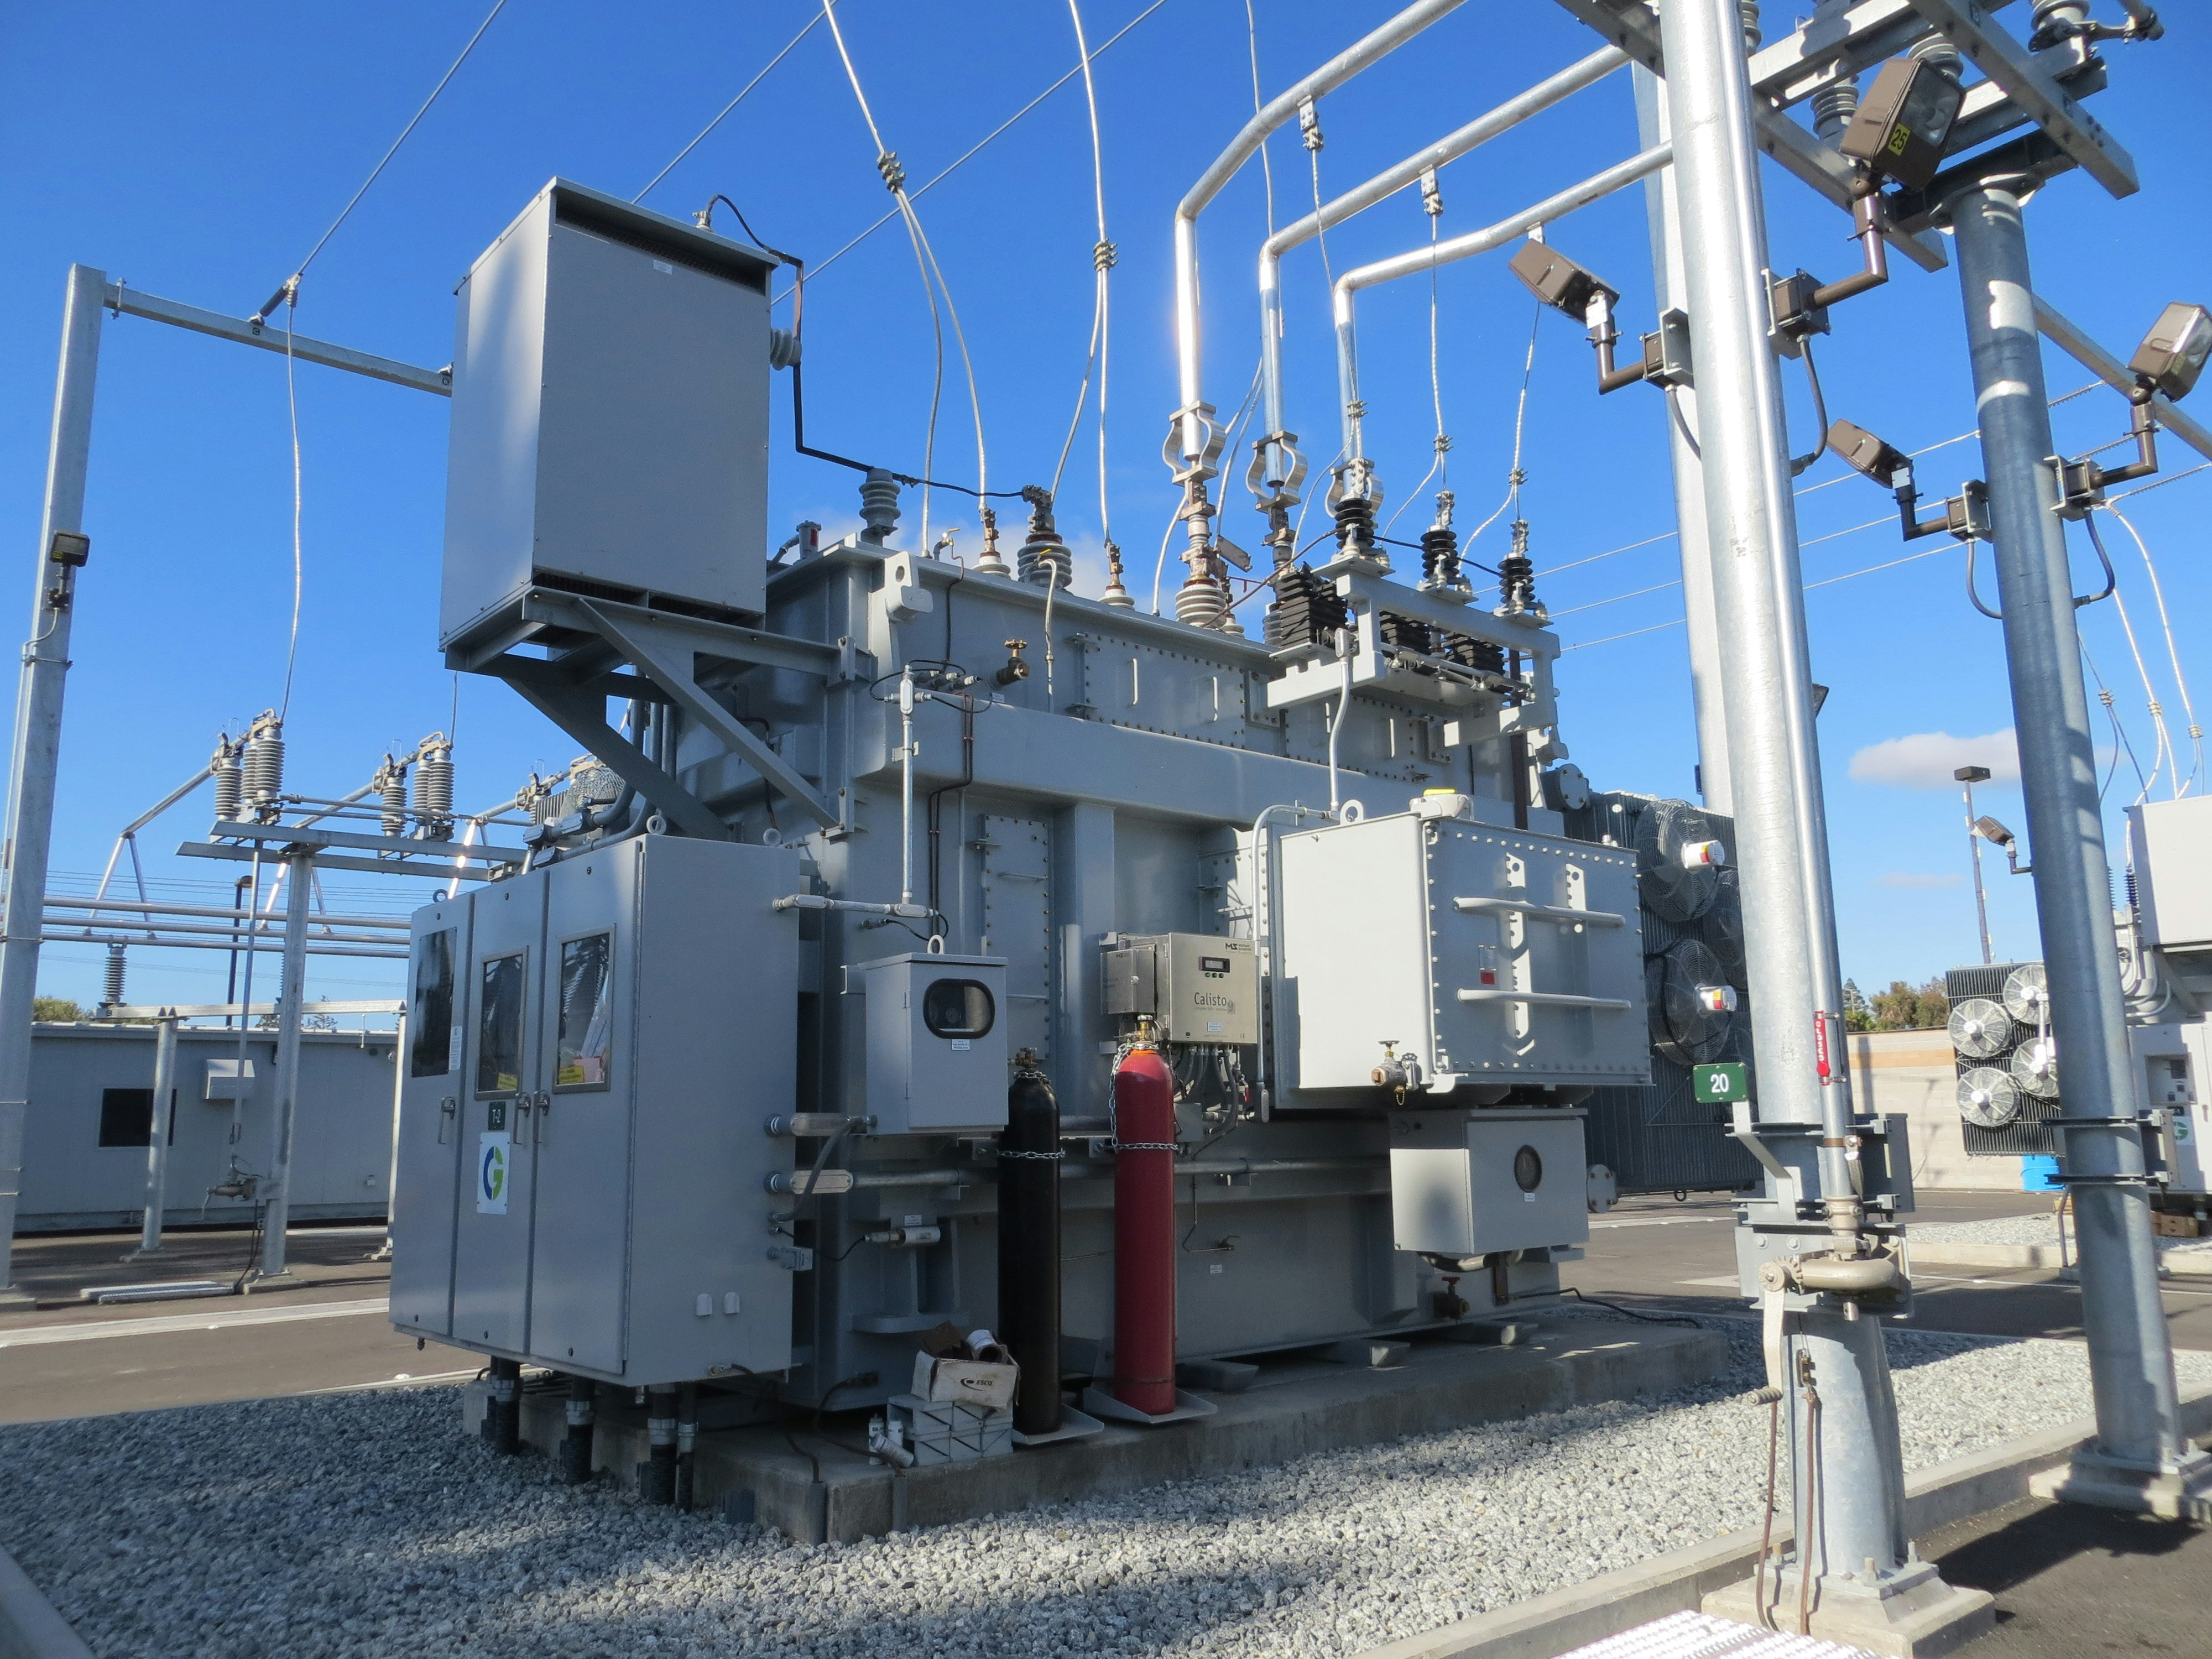
Context of Substations
Substation Automation Evolution
Transition from electromechanical relays to Intelligent Electronic Devices (IEDs)
IEC 61850 protocol and Merging Units (MU)

Slide 3
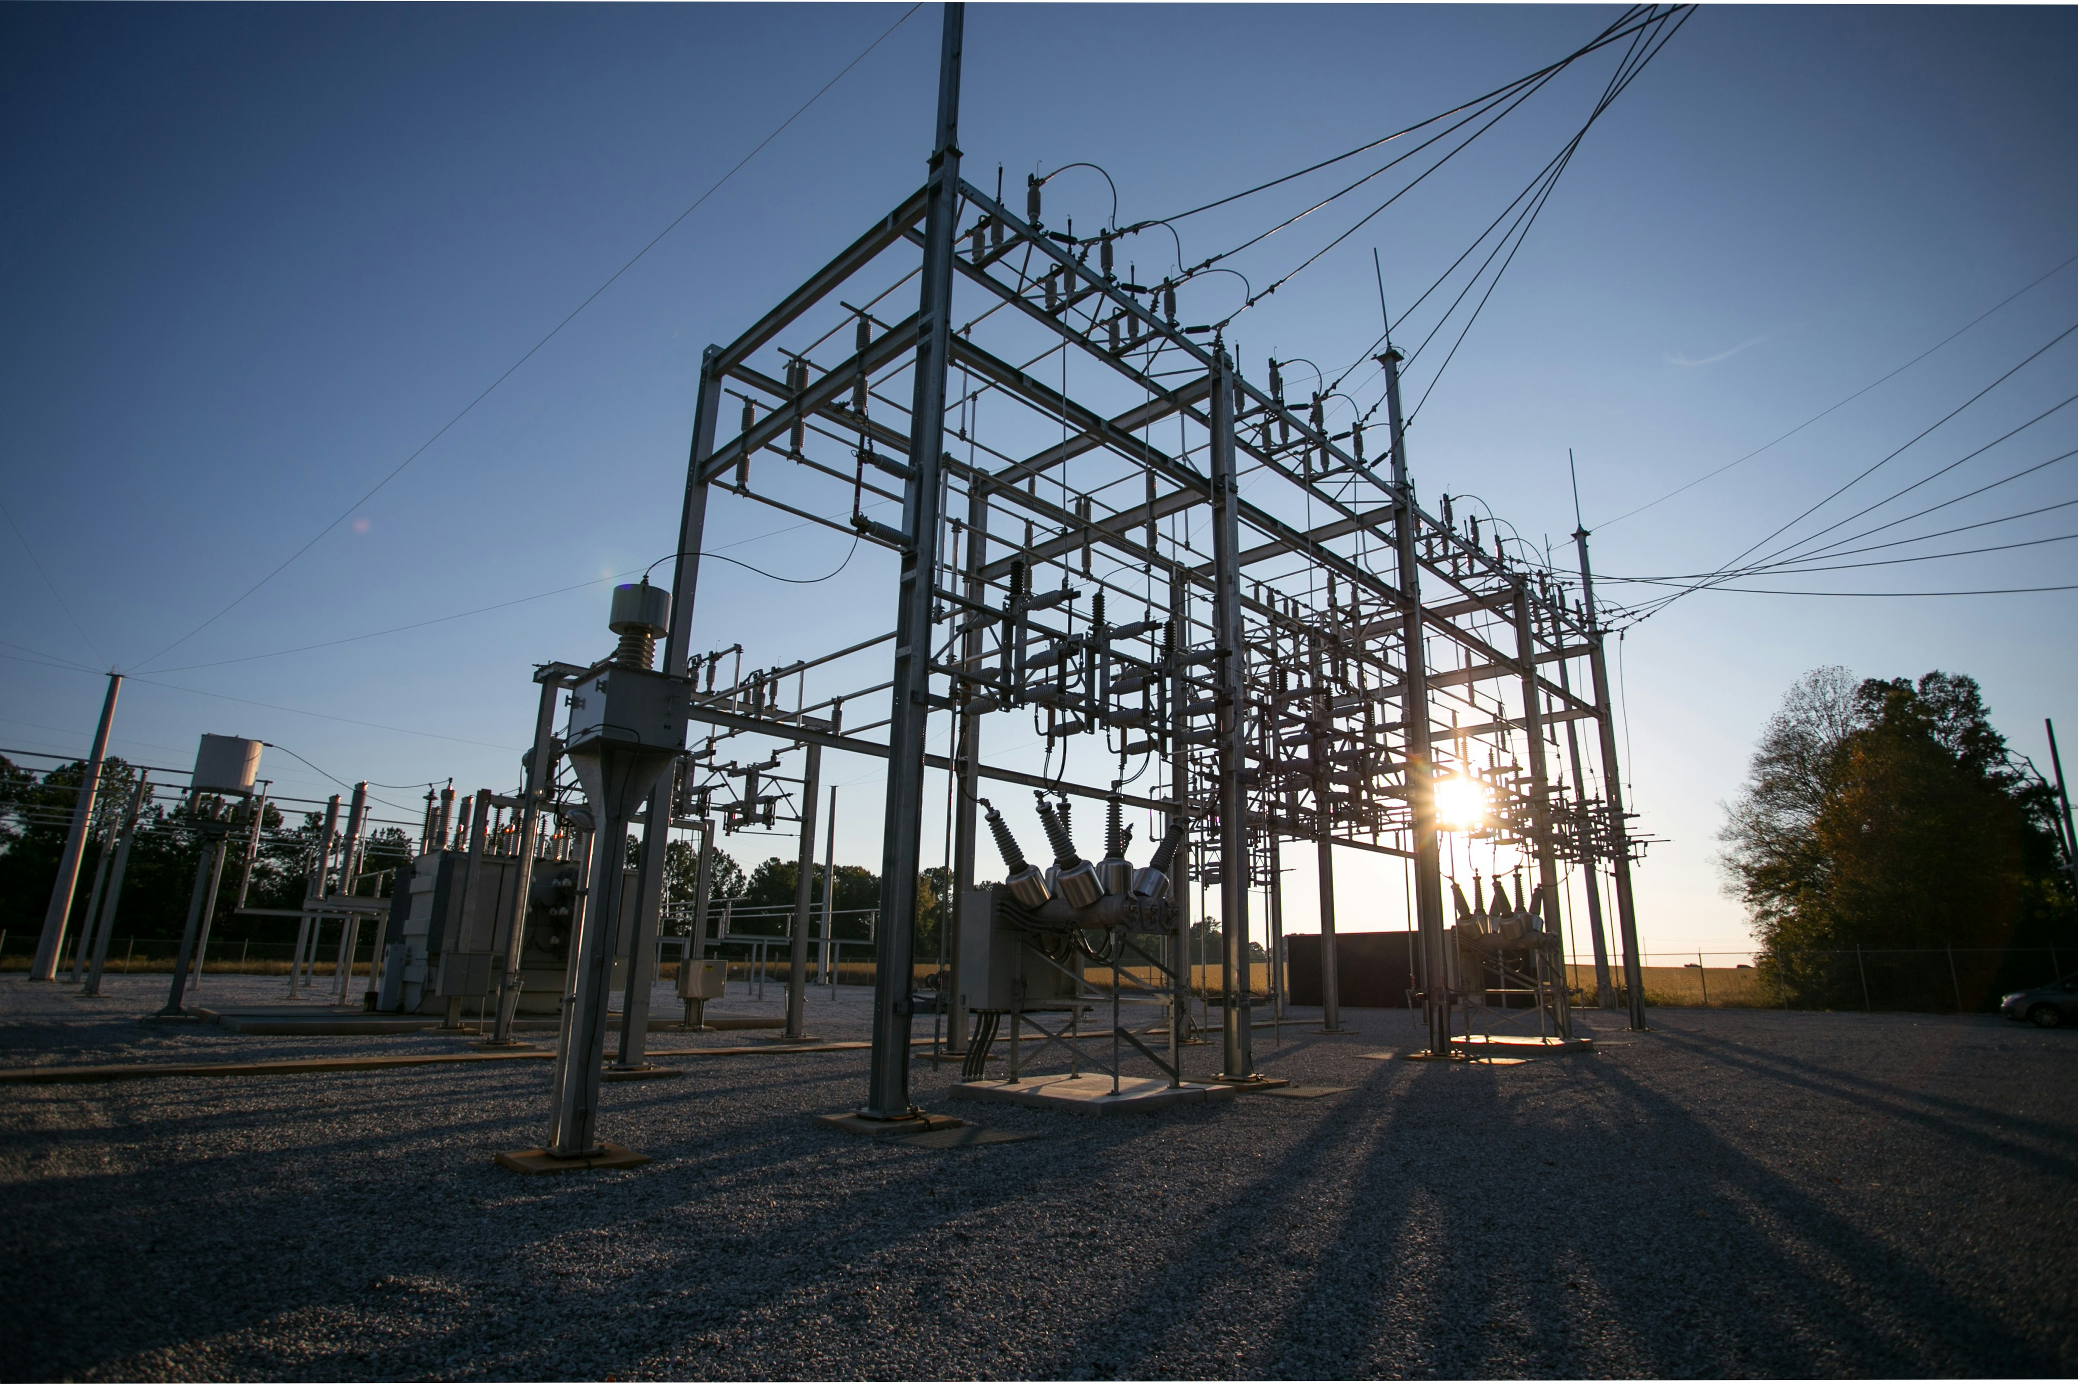
Presentation of the Problem
Overview of the challenges in substation automation
Current issues in protection systems
Need for more dynamic and reliable data sources for SVs in protection relays.

Slide 4
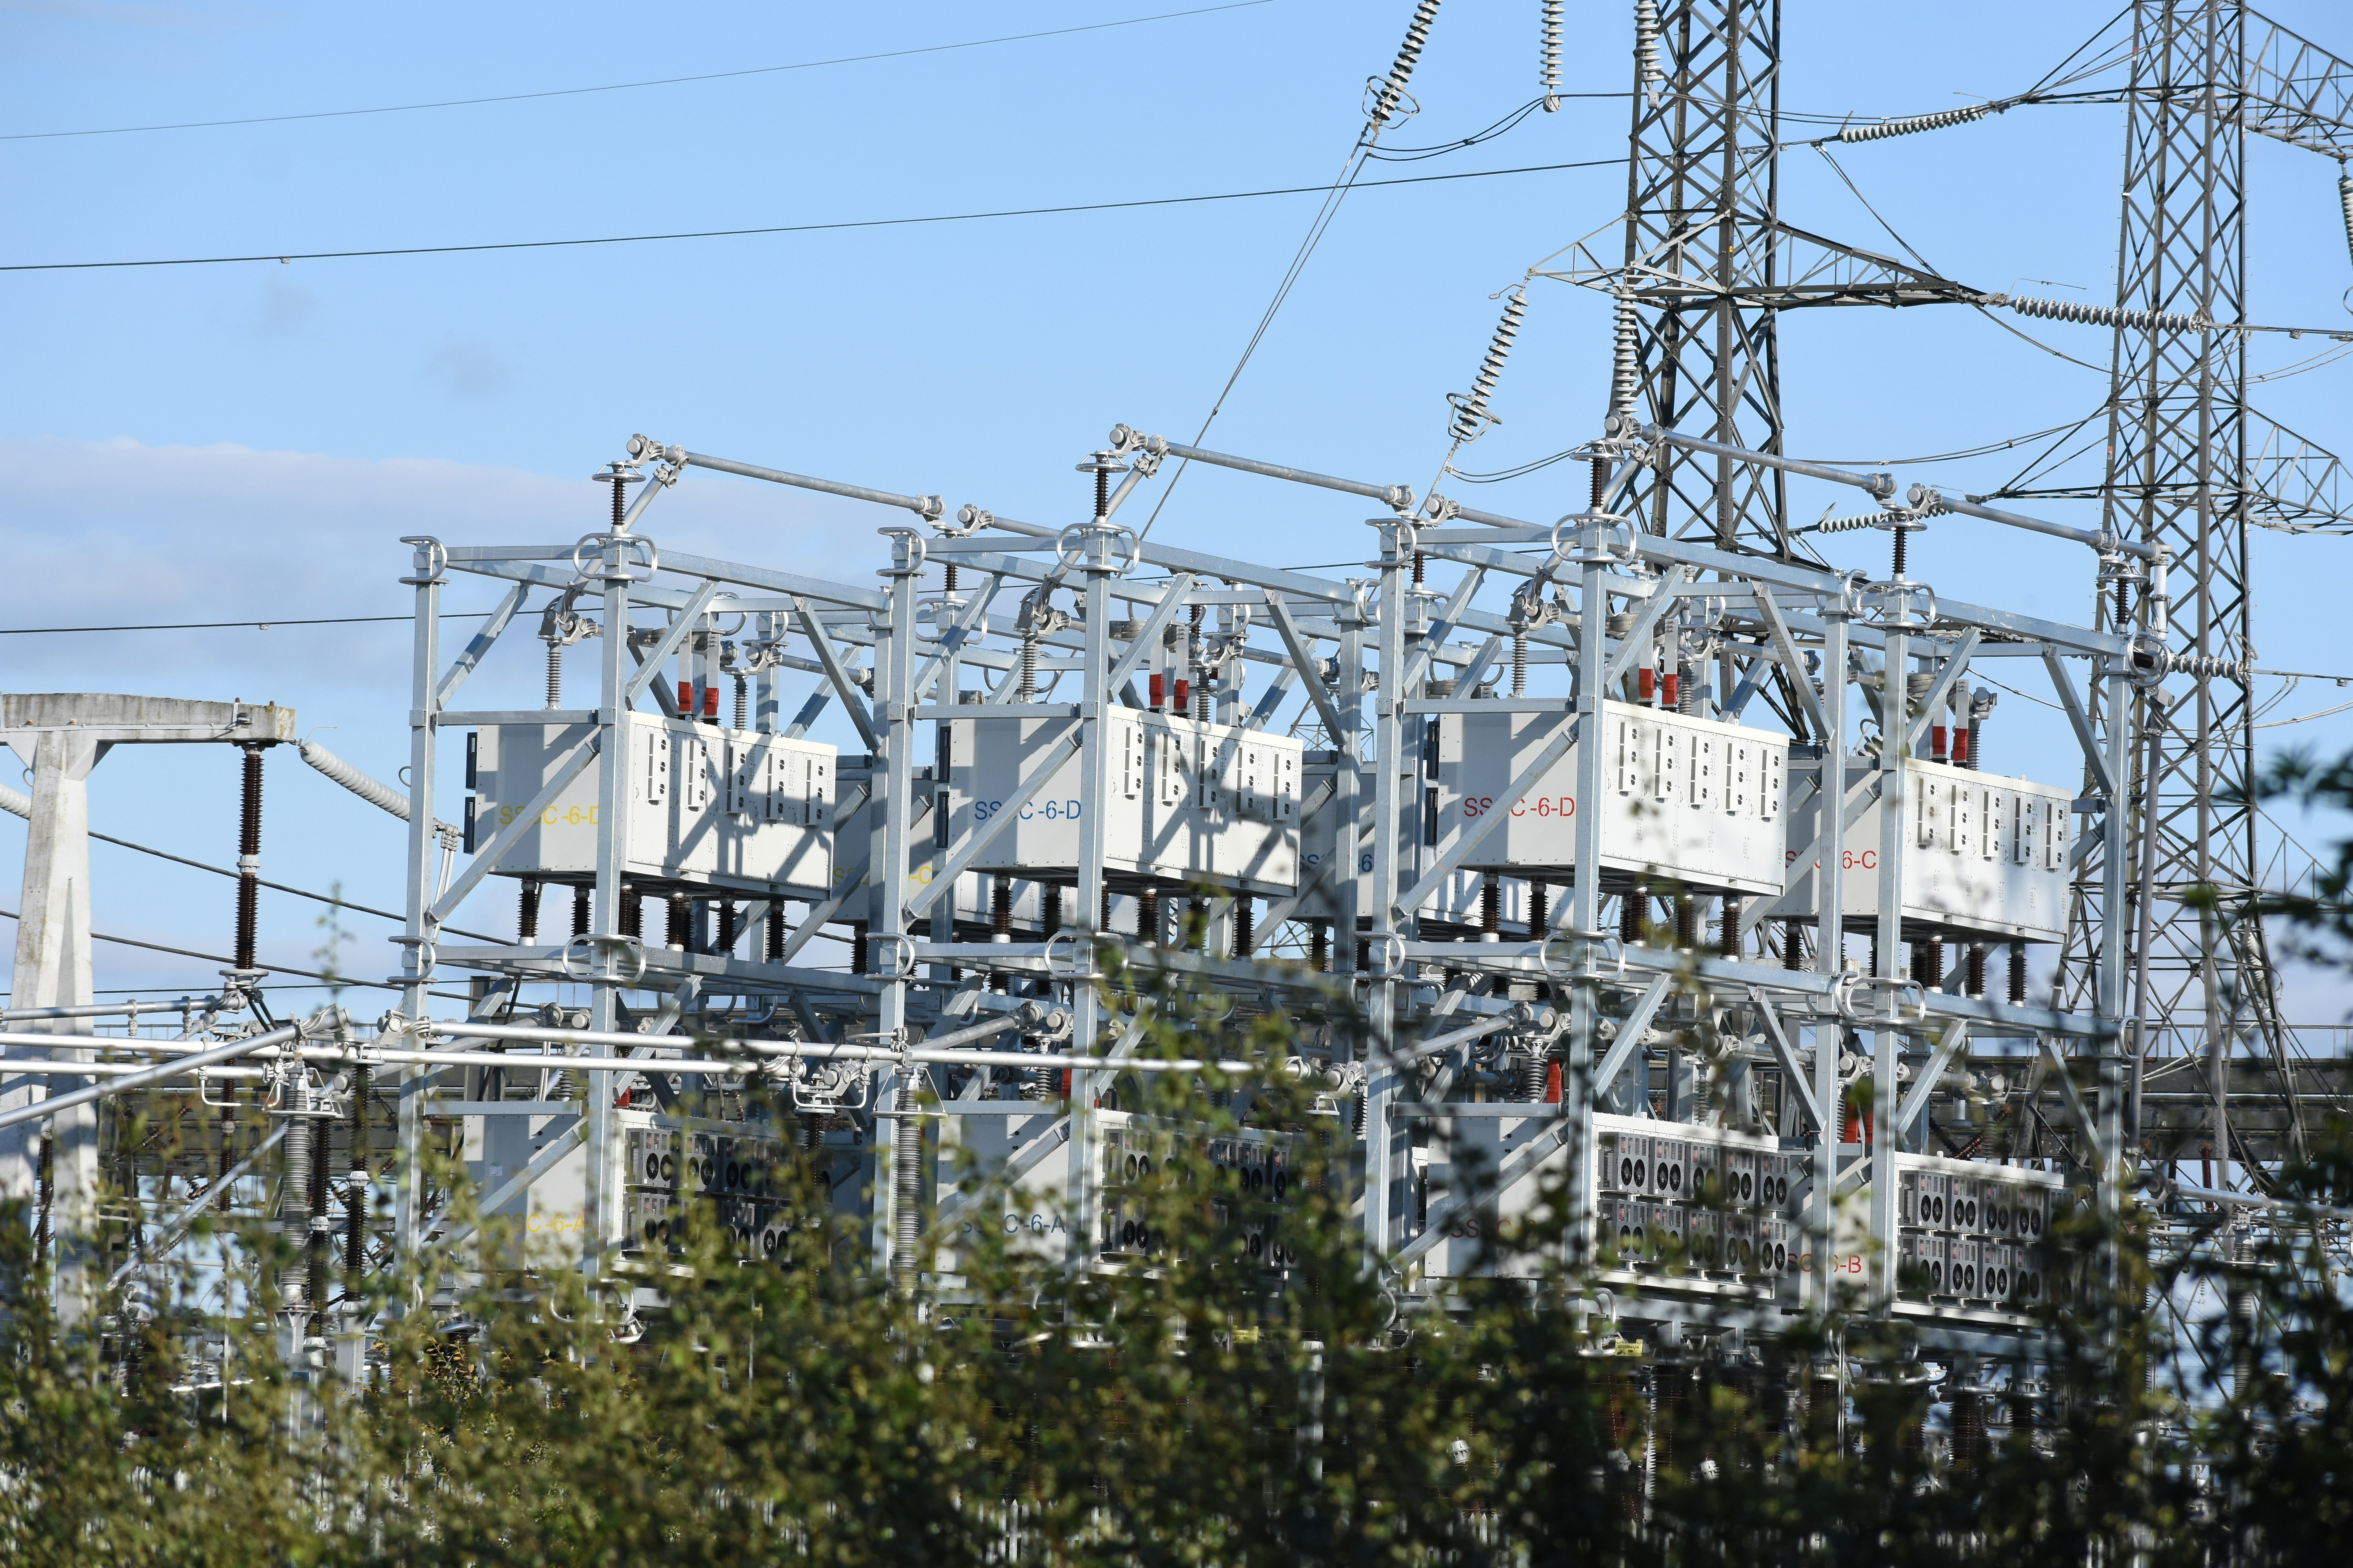
Problem Identification
Challenges with current MU systems
Reliability concerns when switching between sampled values
Inability to select the optimal Sampled Values (SV) in real-time

Slide 5
Vision of the Solution
Proposing a real-time algorithm
Developing an algorithm to select the best SV in real-time based on reliability and performance.
This ensures better decision-making in protection relays.

Slide 6
System Architecture
Merging Unit, Publisher, Subscriber, Protection Relay
Integration of the state machine for SV selection

Slide 7
Implementation
Building the publisher and subscriber for SVs
State machine implementation for optimal SV selection
Error handling and synchronization improvements

Slide 8
State Machine Logic
Receives SVs from two sources
Validates the quality of SV
Selects the optimal SV based on predefined metrics (error rate, latency)

Slide 9
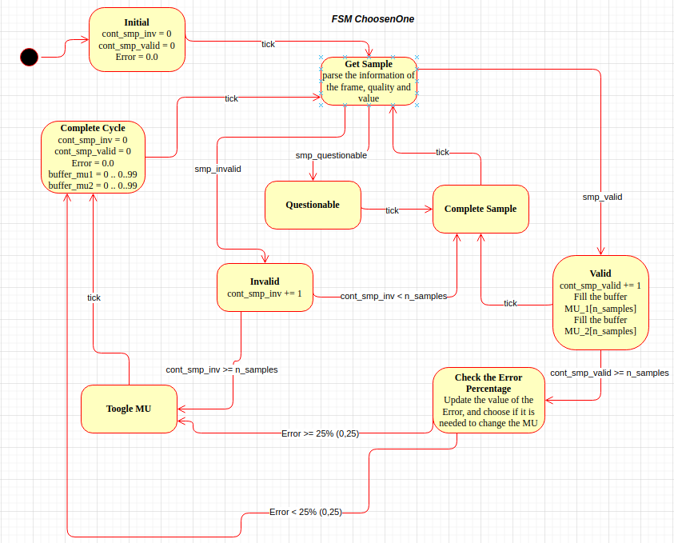
State Machine

Slide 10
Demonstration
Simulated signals: using test setup with publisher/subscriber

Slide 11
Analysis of Results
Algorithm successfully selects optimal SV in real-time
Improved fault detection and faster response times in protection relays
Demonstrated stability and efficiency in both test scenarios

Slide 12
Challenges and Limitations
Synchronization issues between the publisher and subscriber
Latency issues during tests because doesn’t have a good source time as needed

Slide 13
Conclusion
Developed an algorithm to dynamically select the best SV
Enhanced the reliability of protection relays
Contributed to advancements in digital substation automation

Slide 14
Question & Answers
Thanks for your attention!
Any questions?

